Slide 1

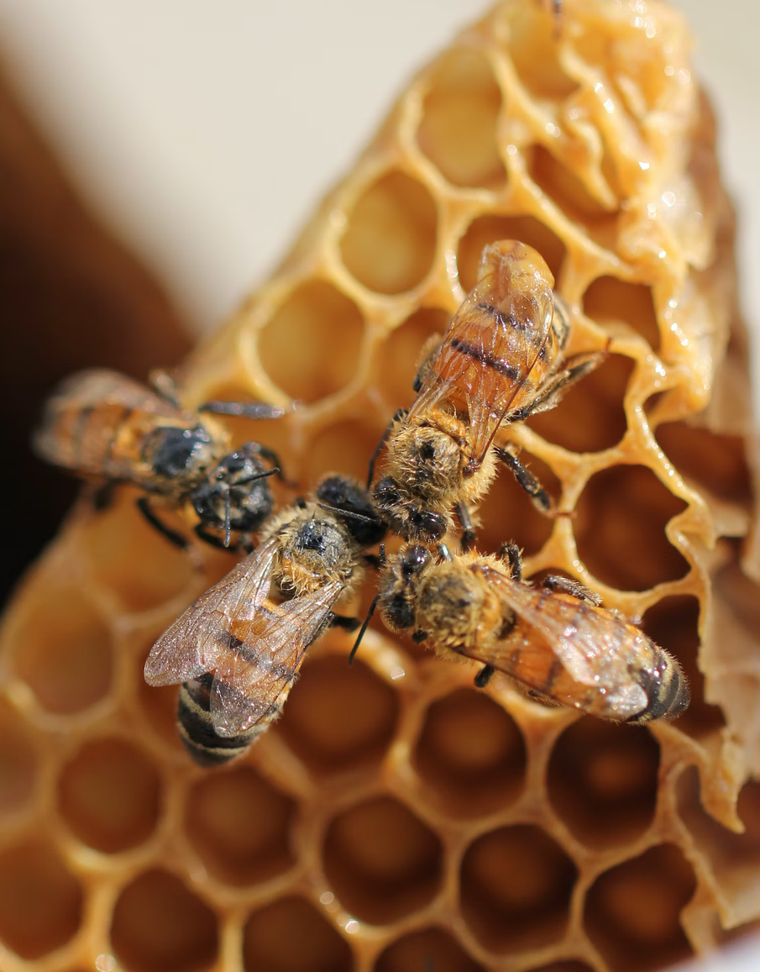
IoT Based Beehive Monitoring for Efficient Honey Production

Slide 2
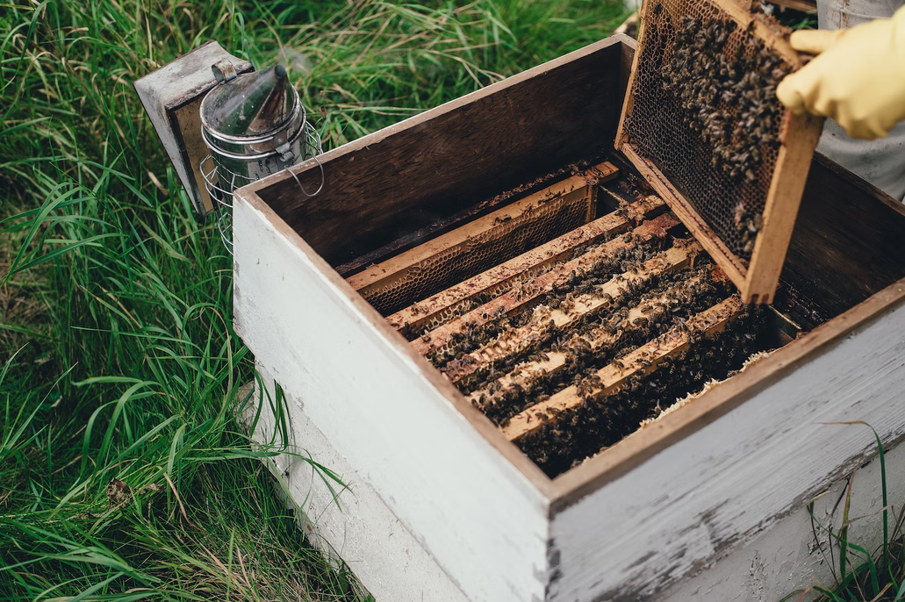
Problem Statement
There are two main objectives in our research
01
Increasing the Honey production
02
Empowering the Beekeepers
Beekeeping plays a pivotal role in:
agriculture
pollination
honey production
We monitor parameters:
Temperature
Humidity
sound
Empower the beekeepers by providing them with real-time data which opens up new avenues for Apiculture management which in turn helps to increase productivity and manage the health of the beehive. Our work also includes to suggest when the Beekeeper can collect the honey
06

Slide 3
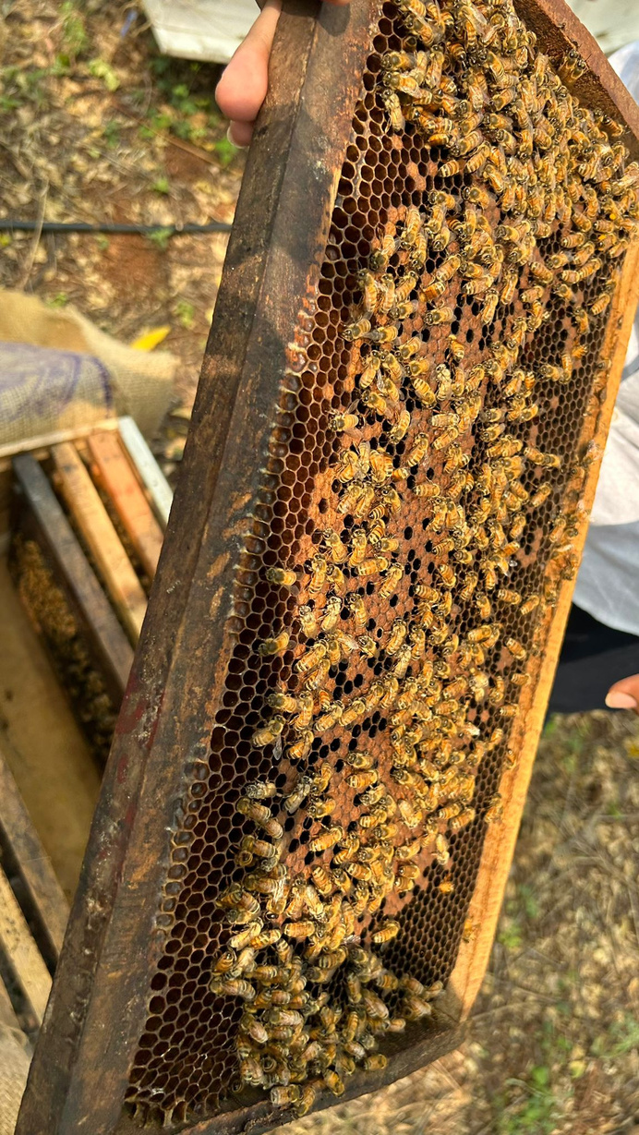
Proposed Methodology
01
Alerting the abnormal death of bees
The proposed solution to the problems identified will help the beekeepers and also improve Honey production
The device detects drastic changes in the frequency (sound) inside the beehive. This is displayed as a red alert in display which indicates bee mortality.
02
Indication to collect honey
Managing multiple beehive boxes turns out to be challenging for the beekeepers, especially for monitoring honey production. To simplify the task, remote monitoring and hive sensors are planned to be used, which will provide the beekeeper with real-time data to identify when honey is ready for collection.
07

Slide 4
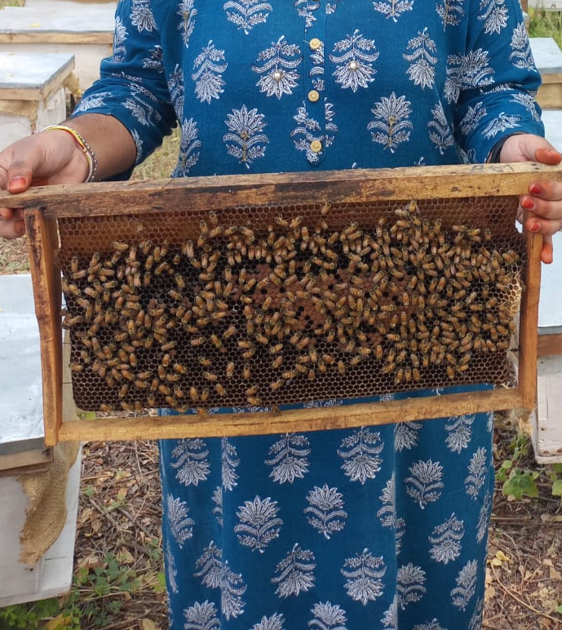
03
Estimation of count of bees in the beehive
Having the count of Bees helps beekeepers in Estimating the Health of Beehive and take necessary Actions
04
Sensing the movement in the Beehives
Bears are known to target beehives for honey. Implementing an alert which gets triggered when the presence of a bear is detected can help to notify the beekeepers, enabling them to take timely action.
07

Slide 5
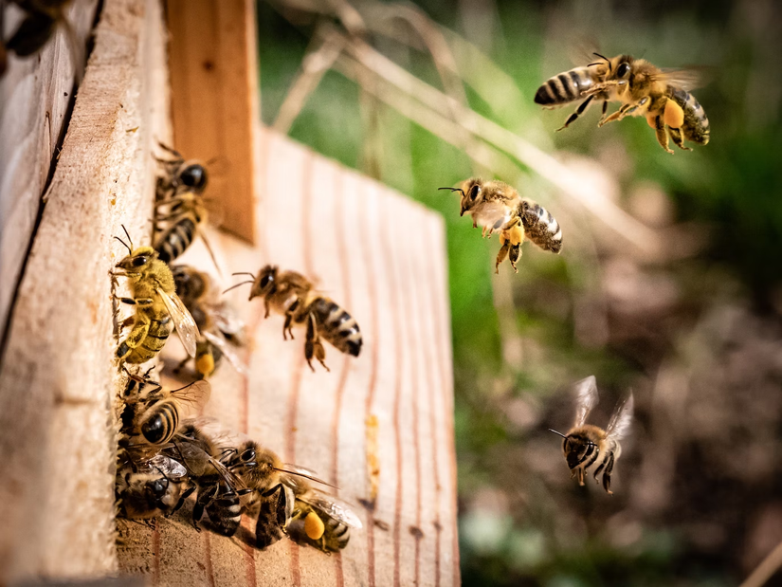
05
Determining the time of feed
Based on the change in weight of the Beehive we can suggest Beekeepers to feed syrup so that the Bees can survive during any drastic climatic conditions
Monitoring Temperature and Humidity For predicting swarming activites of bees
06
A sudden significant increase in temperature and humidity is an indicator of swarming. The beekeeper can move the new queen into a new box.
07

Slide 6
Monitoring Air Quality for Tracking stress in bees
07
Poor Air Quality Is Linked to Stress in Honeybees and Can Be Compounded by the Presence of Disease
07

Slide 7
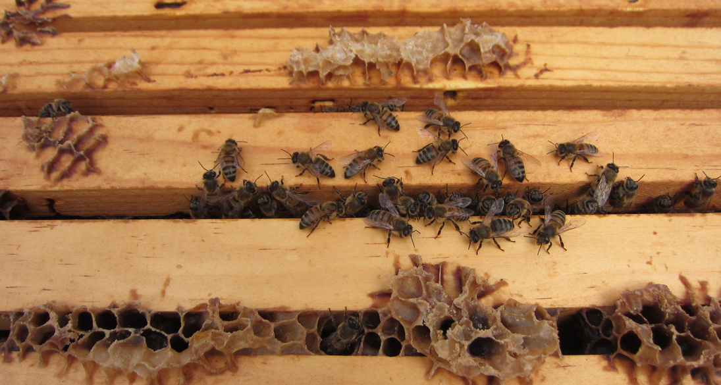
1. Alternating the abnormal death of bees
This alert serves as a crucial early warning for the beekeepers, enabling them to take swift actions such as relocating the remaining frames to a more suitable environment to safeguard the colony.
03

Slide 8
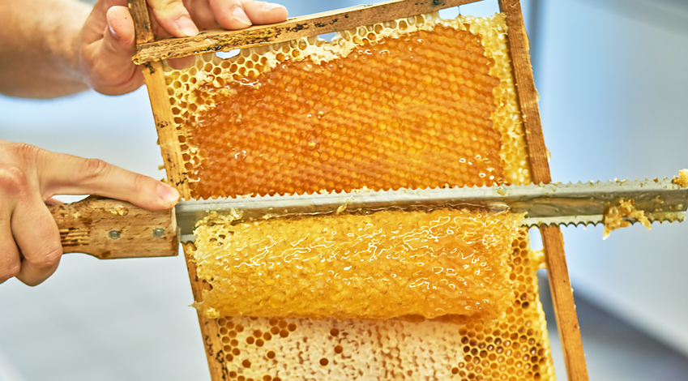
2. Indication to collect honey
Managing multiple beehive boxes turns out to be challenging for the beekeepers, especially for monitoring honey production. To simplify the task, remote monitoring and hive sensors are planned to be used, which will provide the beekeeper with real-time data to identify when honey is ready for collection.
03

Slide 9
Honeybee colony weight (C(g)) was related to honey stored (H(g)), but this relationship
was not linear due to an increased population of mature and immature bees in the
middle of the active season. Honey stored was shown to be dependent on the number of
days (D) from the beginning of the honey harvest. These factors were related for the
study area by the polynomial:
H = -1416.0 + 0.07604 *C - 57.142 * D + 0.487 * D*D + 0.00142 *C * D
03

Slide 10
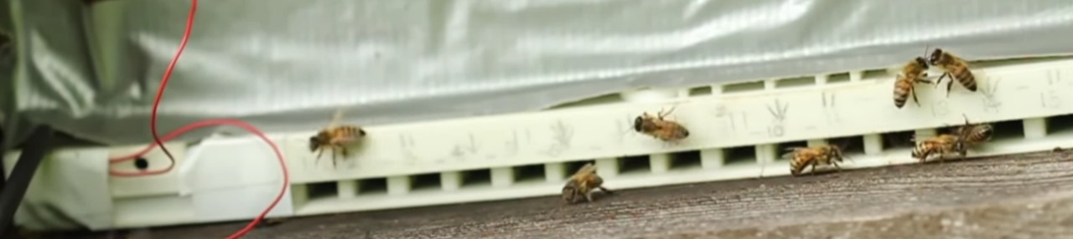
3. Estimation of bees in the beehive
Arizona University, College of Agriculture and Life Sciences came up with a formula to calculate the
number of bees in a hive. It is based on the average number of bees leaving the hive to forage every day (about a third of the colony), the average number of flights per day by a single bee, and the amount of time spent foraging.
N = 3 x (f/0.0138)
Where:
N = number of bees in the hive
f = number of bees seen leaving the nest in one minute
03

Slide 11
The above method is used to count the number of worker bees leaving the hive during active foraging time.
If a beekeeper observes 150 bees leaving a hive in one minute, then there will be about 32,600 bees in the hive (150/0.0138 x 3).
They note that the value of 0.0138 is based on the average amount of time spent foraging for an average
honey bee colony on an average day, and that this value will actually change considerably depending on the amount of food available, weather conditions and so on.
03

Slide 12
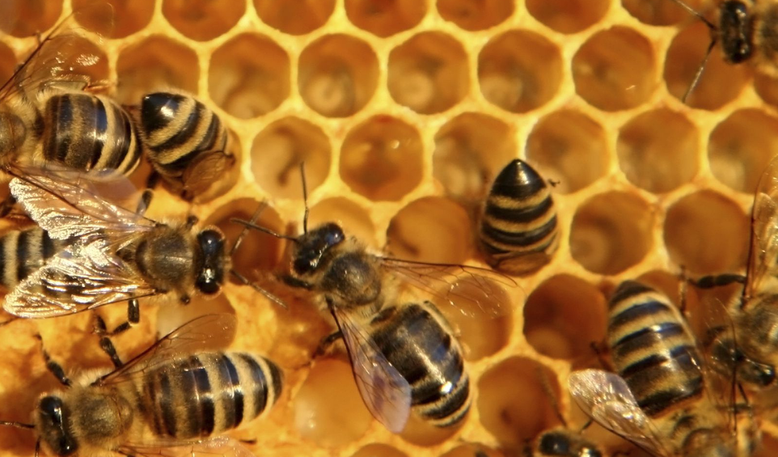
4. Sensing of Movement of bees
Bears are known to target beehives for honey. Implementing an alert which gets triggered when the presence of a bear is detected can help to notify the beekeepers, enabling them to take timely action.
03

Slide 13
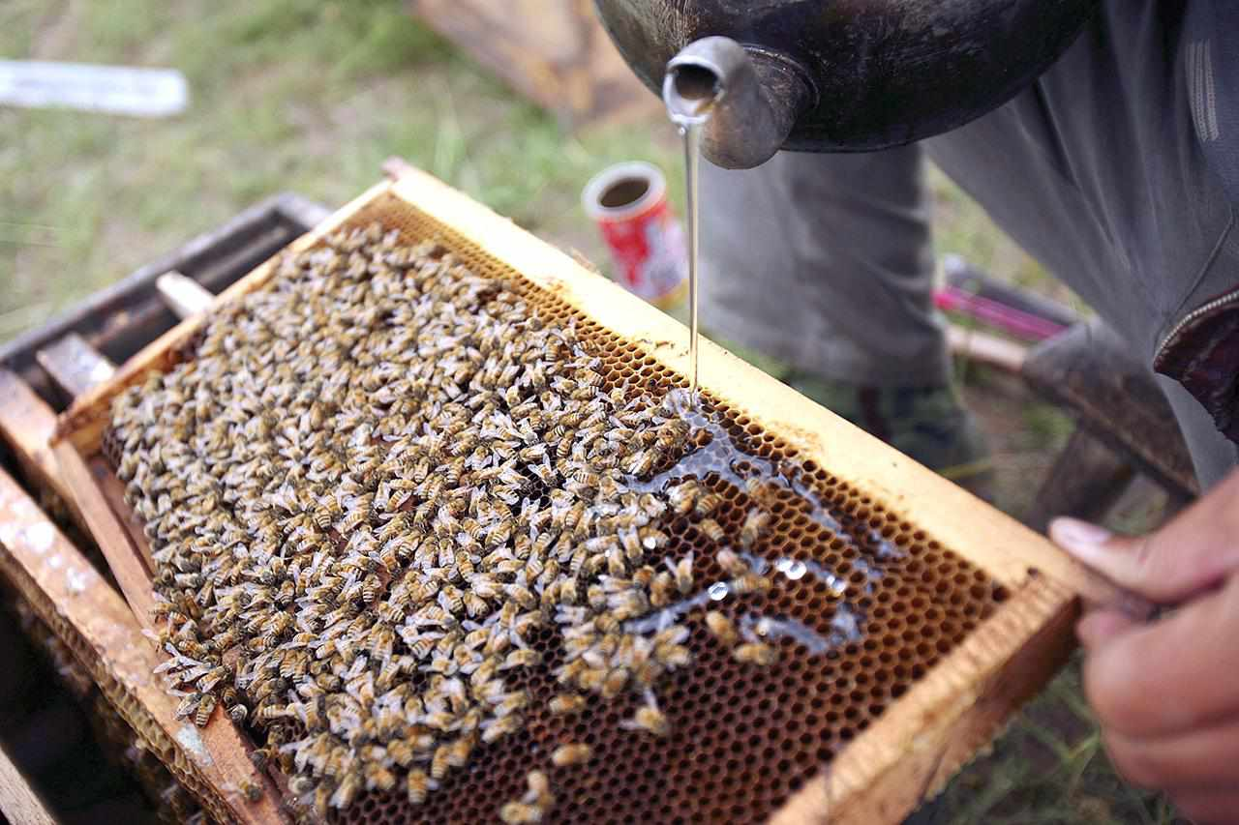

5. Determining the time for feed
If your beehives feel light, promptly supplement their feed until natural nectar sources are available. Bees consume the feed directly, so spring feed is temporary. The risk of starvation persists even with supplemental feed. Commonly, beekeepers use sugar syrup with a 50% sucrose content (1:1 sugar to water by weight), or a 70% sucrose content (2:1 sugar to water by weight). The time to feed the bees can be predicted from weight of Beehive.
03

Slide 14
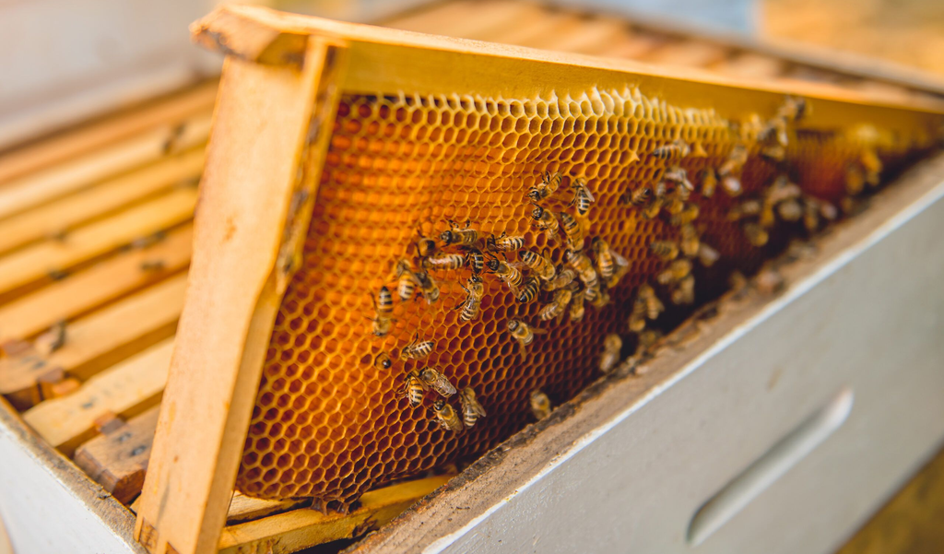
6. Monitoring Temperature and Humidity For predicting swarming activites of bees
As the temperature increases, it serves as an indicator of swarming in bees. The beekeeper can take necessary steps to move the new queen into a new colony.
03

Slide 15
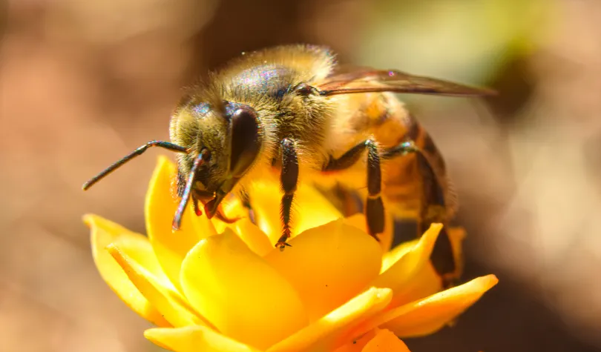
7. Monitoring Air Quality for Tracking stress in bees
They are highly sensitive to changes in their environment, including air quality, which can impact their health and well-being.
Gas sensor is used to measure the air quality.
03

Slide 16
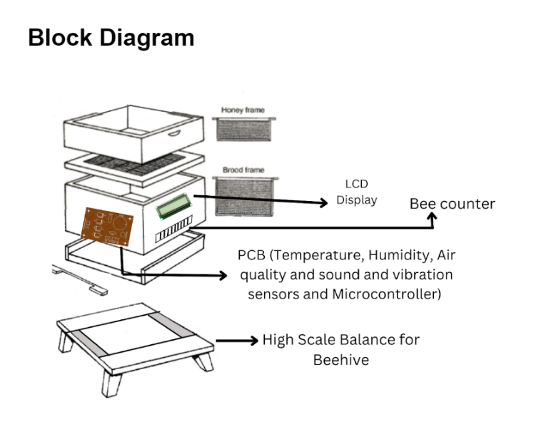
BLOCK DIAGRAM
03

Slide 17

Protocol Used
03

Slide 18
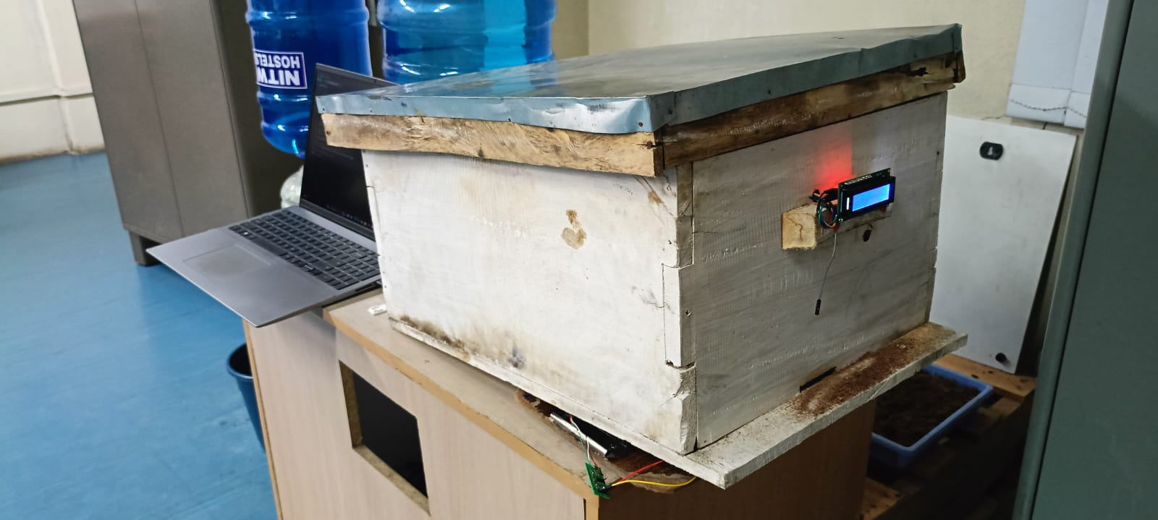
Final Prototype
03

Slide 19
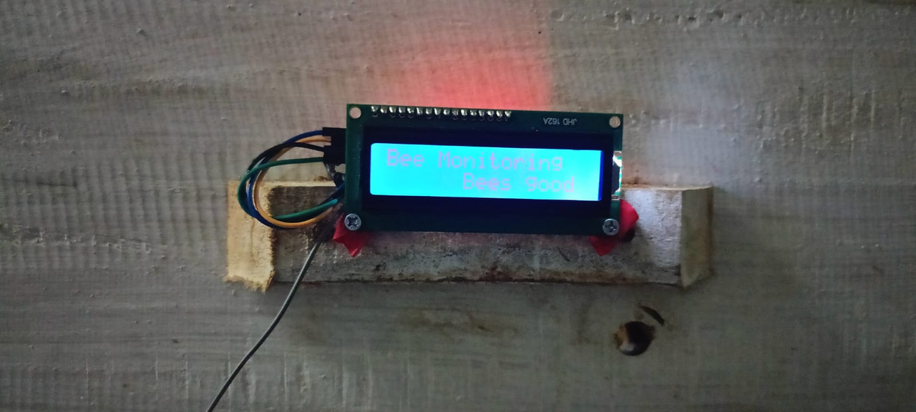
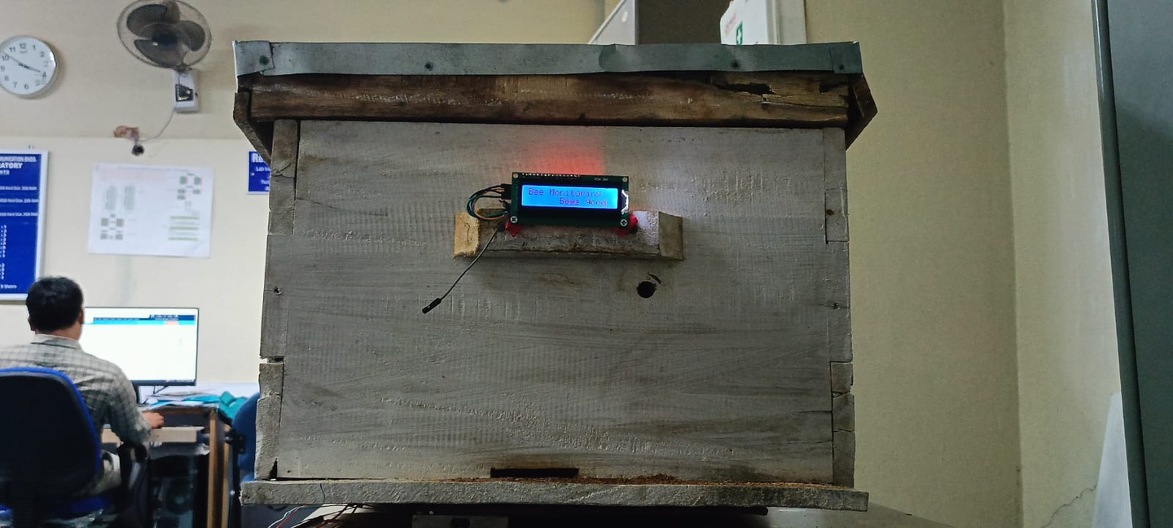
03

Slide 20
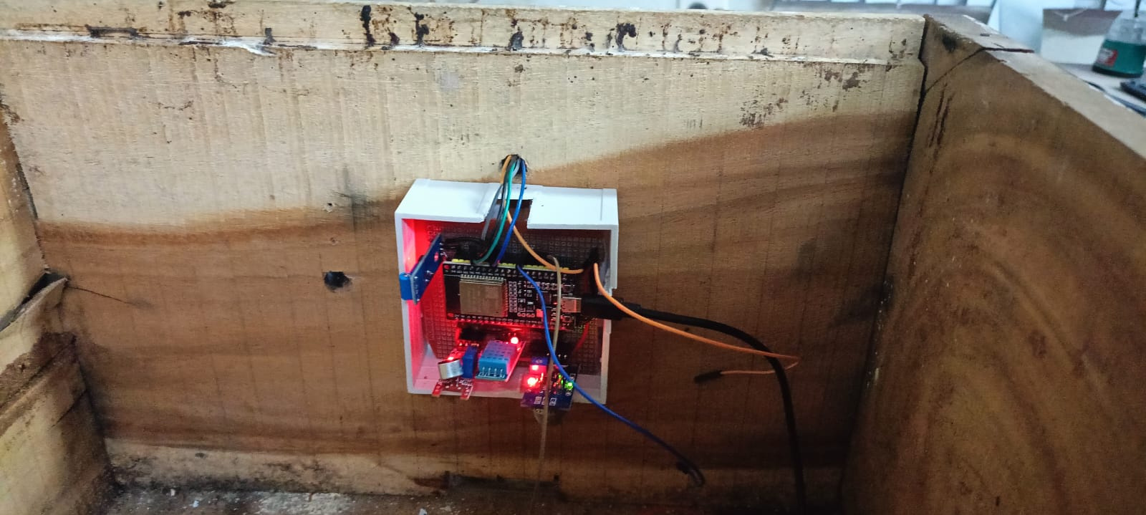
03

Slide 21
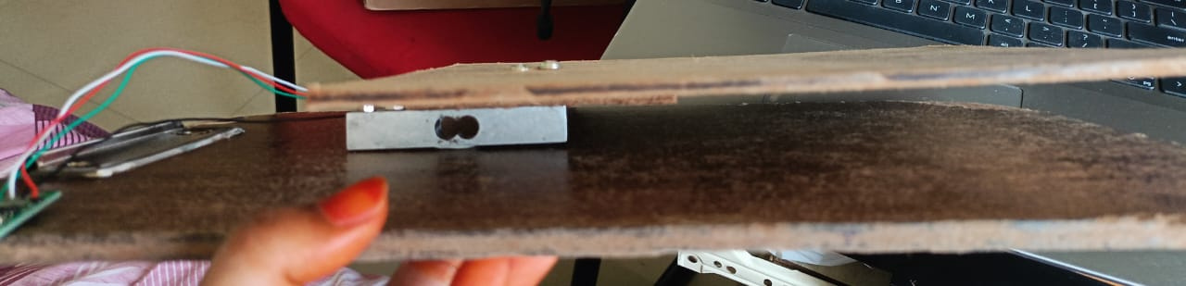
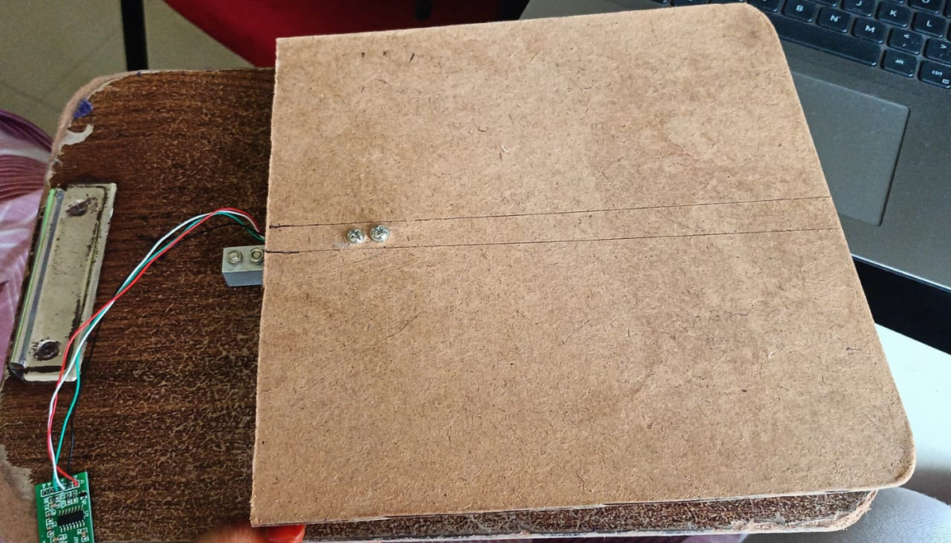
03

